Slide 1
Smart Cart
A Scalable Microservices-Based E-Commerce Platform

Slide 2
Table of Contents
Problem Statement
Our Objectives
System Overview
Technology Stack
Architecture & Design
System Architecture
Use Case Diagram
Sequence Diagram
ER Diagram
System Features
Project Screenshots
Conclusion
Future Enhancements

Slide 3
Problem Statement
Traditional monolithic e-commerce platforms suffer from tight coupling, making even small changes require a full system redeployment.
Scaling bottlenecks — if the product catalog gets heavy traffic, the entire application must be scaled up, wasting resources.
Single point of failure — one service crashing brings down the entire application.
Managing multiple user roles (Customer, Vendor, Admin) within one codebase leads to complex, unmaintainable code.
Slow development cycles — different teams cannot work independently on different modules.
Lack of a real-time notification system for order updates and payment confirmations.
No separation of data — all entities share one large database, creating data coupling.

Slide 4
Our Objectives
Design and develop a fully functional e-commerce platform using a microservices architecture.
Implement role-based access control for three roles: Customer, Vendor, and Admin.
Build an API Gateway as a single entry point for all client requests with JWT authentication.
Use Netflix Eureka for dynamic service discovery and load balancing.
Integrate Apache Kafka for asynchronous, event-driven communication between services.
Implement a Razorpay payment gateway for secure online transactions.
Provide real-time email/SMS notifications for order and payment events.
Containerize all services using Docker for consistent deployment.
Build a modern React.js frontend that communicates through the API Gateway.
Ensure each microservice maintains its own independent MySQL database.

Slide 5
System Overview
What is Smart Cart?
Smart Cart is a cloud-ready, microservices-based e-commerce platform that enables customers to browse products, manage carts, place orders, and make payments — while vendors can list products and admins can manage the entire platform — all through a unified React frontend and secured API Gateway.
Feature | Detail
Architecture | Microservices (10 independent services)
Security | JWT-based authentication via API Gateway
Messaging | Apache Kafka (event-driven)
Payments | Razorpay Integration
Deployment | Docker + Docker Compose
Frontend | React.js (Single Page Application)
Database | MySQL (one DB per service)
Discovery | Netflix Eureka

Slide 6
Technology Stack
Backend
Database
Technology | Purpose
Java 17 | Primary programming language
Spring Boot 3.x | Microservice framework
Spring Security + JWT | Authentication & Authorization
Spring Cloud Gateway | API Gateway / Routing
Netflix Eureka | Service Discovery & Registry
OpenFeign | Synchronous inter-service communication
Apache Kafka | Asynchronous event streaming
Spring Data JPA | ORM / Database access
Lombok | Boilerplate code reduction
Maven | Build & dependency management
Technology | Purpose
MySQL 8.0 | Relational database (one per service)

Slide 7
Frontend Infrastructure & DevOps
Technology | Purpose
React.js | Single Page Application
Axios | HTTP client for API calls
React Router | Client-side routing
Bootstrap / CSS | UI Styling
Technology | Purpose
Docker | Containerization
Docker Compose | Multi-container orchestration
Razorpay API | Payment gateway integration
Postman | API testing

Slide 8
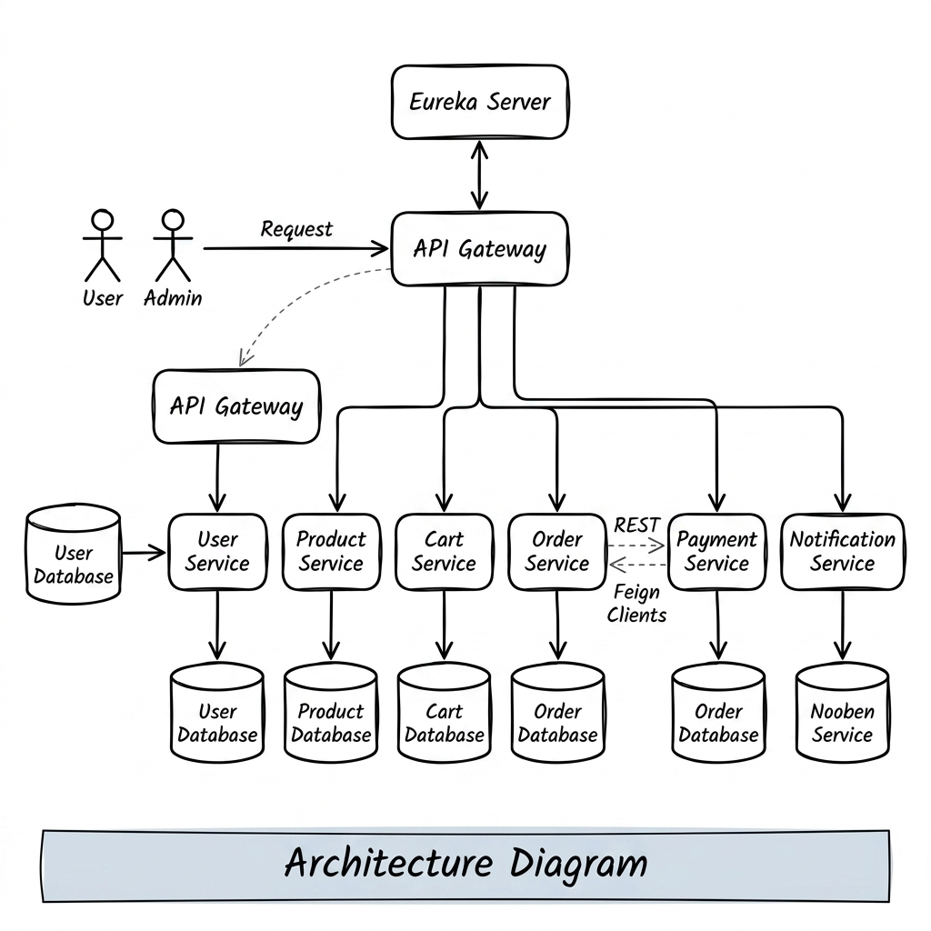
System Architecture
Single Entry Point: All traffic goes through API Gateway
Independent Databases: Each microservice owns its data
Service Discovery: Eureka dynamically registers all services
Feign Clients: Order→Cart, Cart→Product (sync calls)
Kafka Events: Order placed → Payment triggered → Notification sent

Slide 9
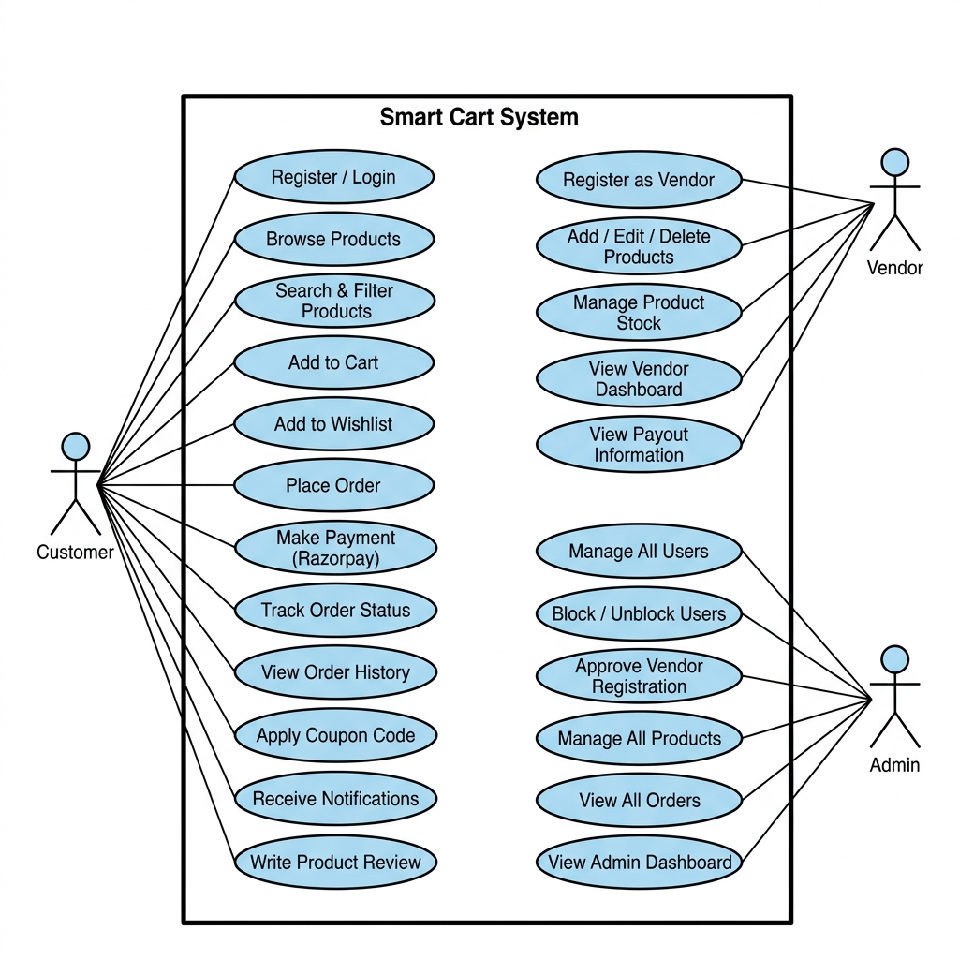
Use Case Diagram

Slide 10
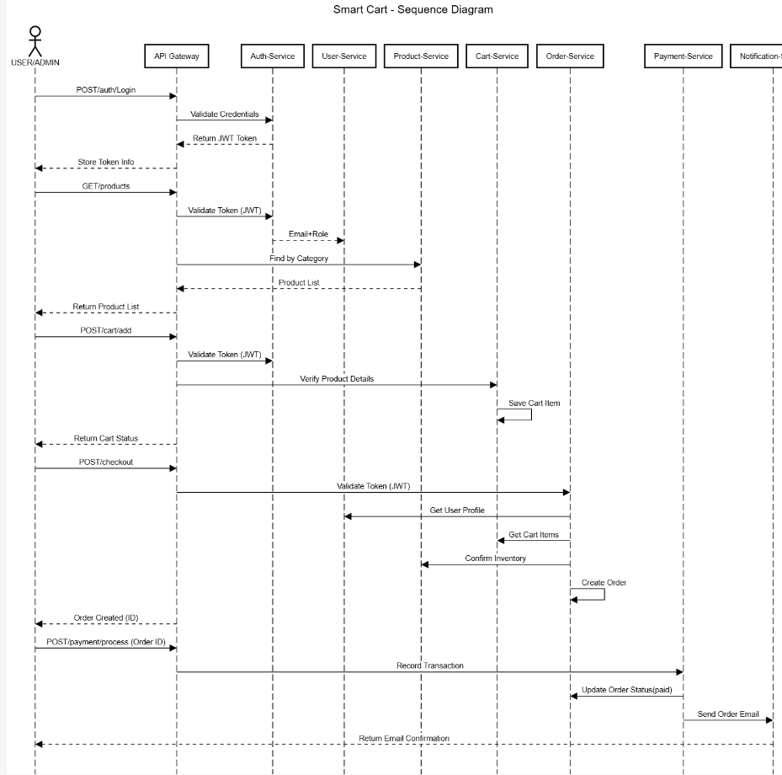
Sequence Diagram — Place Order Flow
Customer logs in → receives JWT Token
Frontend sends Place Order request with JWT
API Gateway validates JWT and routes to Order Service
Order Service fetches cart via Feign Client
Order is saved to Order DB
Kafka event ORDER_PLACED is published
Payment Service consumes event and processes Razorpay payment
Payment Service publishes PAYMENT_DONE event
Notification Service consumes event and sends email/SMS

Slide 11
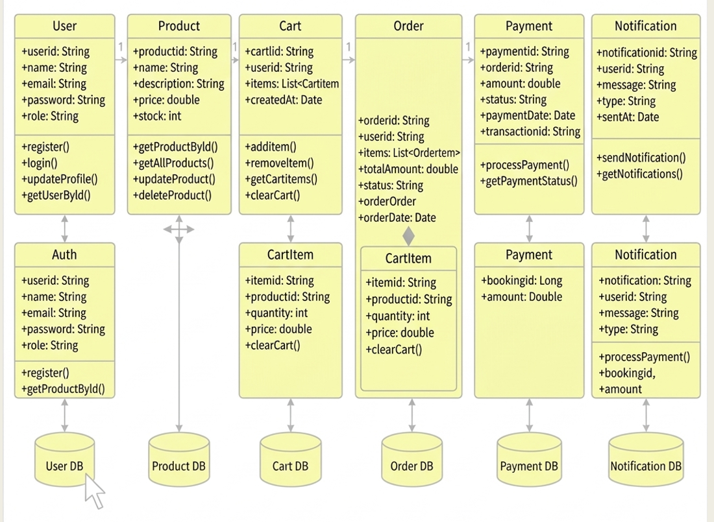
ER Diagram

Slide 12
Functionalities: The platform provides the following core functionalities across its microservices:
1.User & Authentication Management
User registration and login with JWT-based authentication
Tracking new users with is_new_user flag
Role-based access control for admin and customers
2.Product Catalog Management
CRUD operations on products
Stock management
Product reviews and ratings
3.Shopping Cart Management
Add, remove, or update product quantities in cart
Check product availability via inter-service communication
Calculate cart totals dynamically

Slide 13
4.Order Processing
Apply discount or coupon codes
Process checkout and create orders
Reduce stock quantities in Product Service
5.Payment Integration
Razorpay payment gateway integration
Secure payment signature verification
Update order status upon successful payment
6.Notification System
Send asynchronous notifications via email or in-app
Welcome messages for new users
Order and payment confirmation alerts
7.Frontend User Interface
Admin dashboard for managing products, orders, and users
Customer dashboard for browsing products, managing cart, and tracking orders
API integration using Axios/Fetch with React

Slide 14
Future Enhancements
# | Enhancement | Description
1 | Elasticsearch Integration | Full-text product search with filters and fuzzy matching
2 | Mobile App | React Native mobile app for Android and iOS
3 | AI Product Recommendations | ML-based personalized product suggestions
4 | Cloud Deployment | Deploy to AWS / Azure / GCP using Kubernetes (K8s)
5 | Analytics Dashboard | Real-time sales analytics with charts for admin
6 | Multi-Language Support | Internationalization (i18n) for multiple languages
7 | Live Chat Support | Real-time customer support using WebSockets
8 | OAuth2 / SSO | Google / GitHub login with Spring Security OAuth2
9 | Inventory Alerts | Auto-notify vendors when stock is low
10 | Flash Sales / Deals | Time-limited offers and promotional pricing
11 | Product Reviews & Ratings | Customer reviews with star rating system
12 | CI/CD Pipeline | Jenkins / GitHub Actions for automated deployment

Slide 15
Conclusion:
Smart Cart successfully demonstrates the power of a microservices architecture applied to a real-world e-commerce platform.
Each service is independently deployable, scalable, and maintainable — solving the core limitations of monolithic systems.
JWT + API Gateway provides centralized, secure authentication without duplicating security logic across services.
Apache Kafka enables loosely coupled, real-time communication between Order, Payment, and Notification services.
Docker ensures the entire system can be brought up consistently on any machine with a single command: docker-compose up.
The React.js frontend provides a seamless, modern user experience with role-based navigation.
The project demonstrates industry-standard practices: service discovery, inter-service Feign communication, event-driven architecture, and containerization.

Slide 16
Thank You / Q&A
"Smart Cart — Built for Scale, Designed for Real World"

